Slide 1
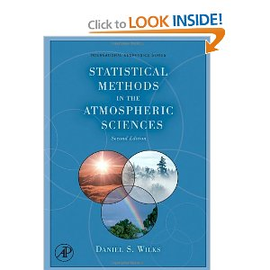


ATMOSPHERIC SCIENCES 5040/6040- Environmental Statistics
Instructors: John Horel, Court Strong
Grader: Chris Foster
Required Text: Matlab Recipes for Earth Sciences.
4th edition is available as a 3-hour reserve through the library
3rd edition is available as a e-book (ok for undergrads)
Recommended if interested in python: Python Programming
Recommended text for 6040: Statistical Methods in the Atmospheric Sciences

Slide 2
Steps for Effective Research
distill a general interest in a subject into a specific question/hypothesis that can be evaluated
organize the data
find relationship(s) among the data
examine the significance of your results
review thoroughly what you have done and document your analysis and results
submit your results and study for independent evaluation

Slide 3
What you should have been doing...
Read Chapter 1 Notes
Read Chapter 1 in text
Complete Assignment 2 based on Chapter 1 notes and text
Due last night

Slide 4
What you will be doing
Class Wed and next Wed in MLIB 1110 (no class Monday)
Read chapter 2 in text
Read chapter 2 Notes
In class Assignment 3 on Wednesday
Complete Assignment 4 as really basic introduction to Matlab
Due 22nd

Slide 5


Slide 6
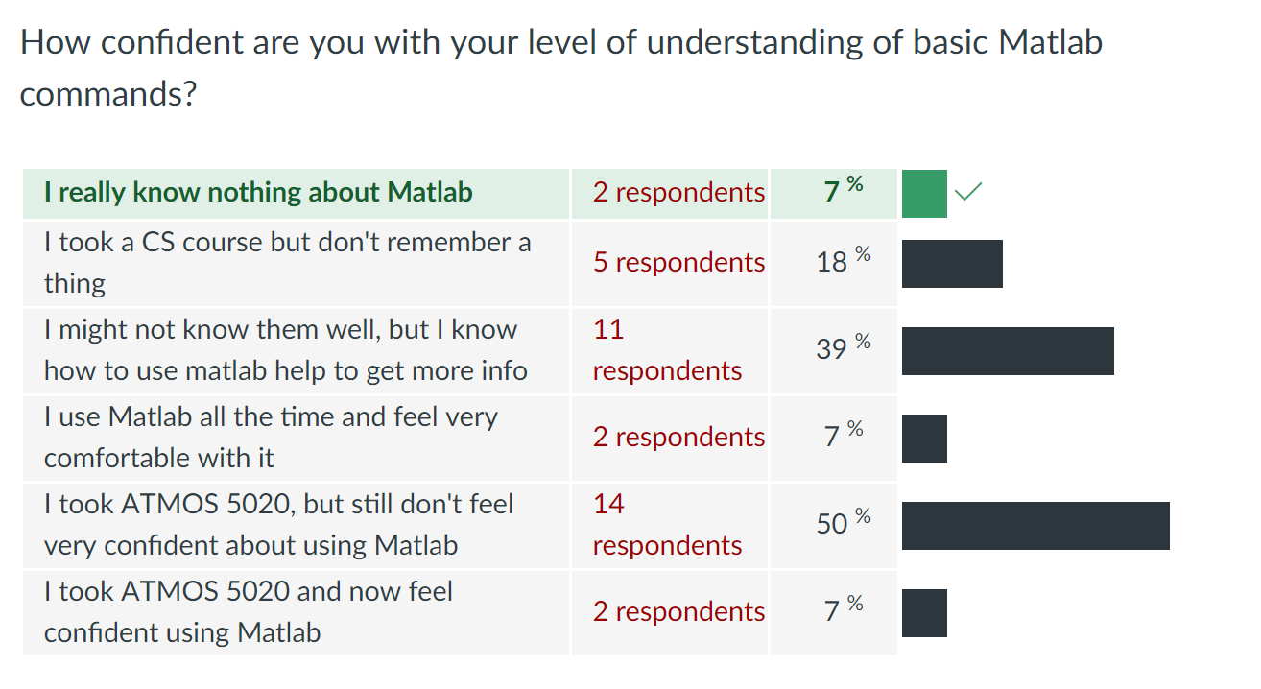

Slide 7
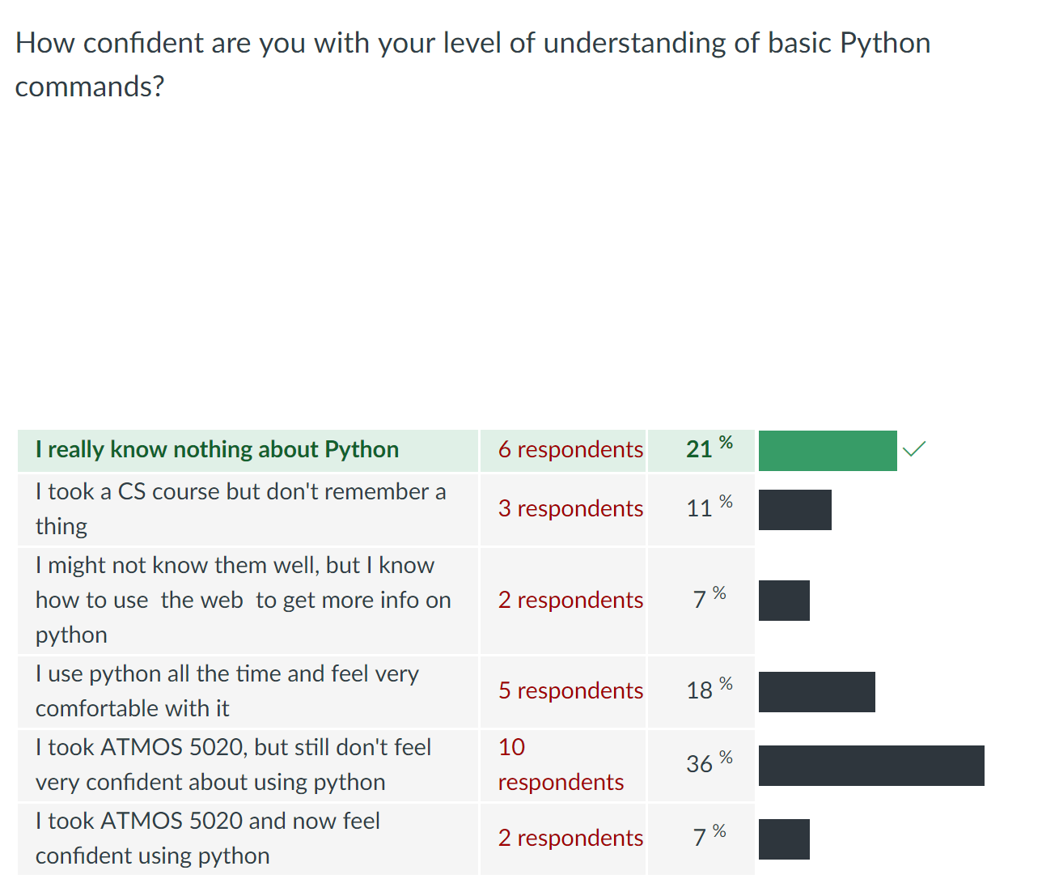

Slide 8
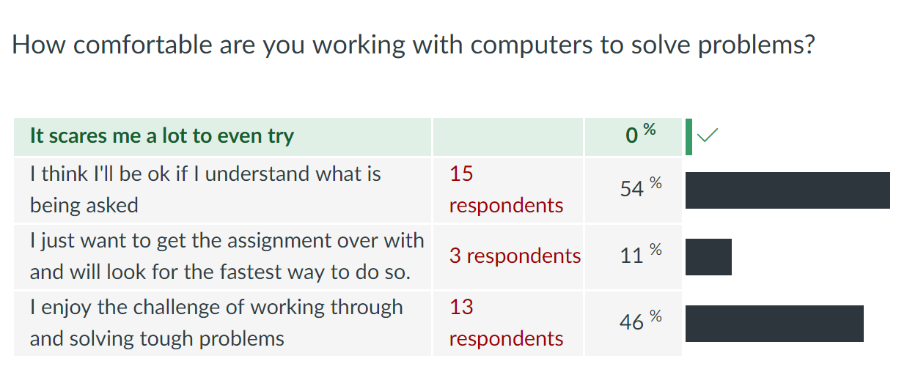

Slide 9
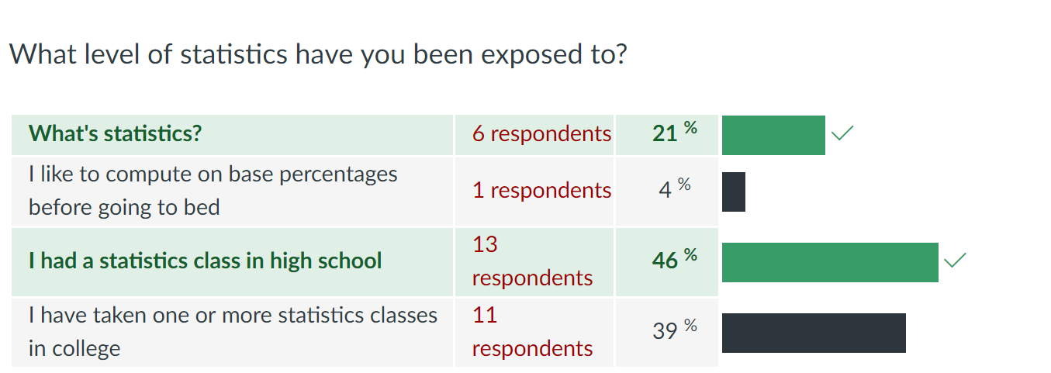

Slide 10
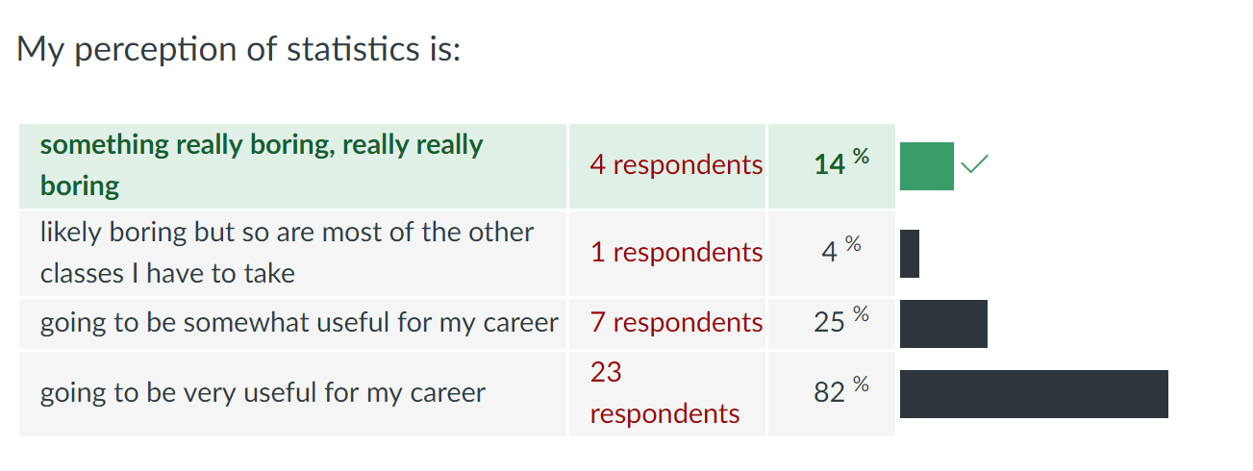

Slide 11
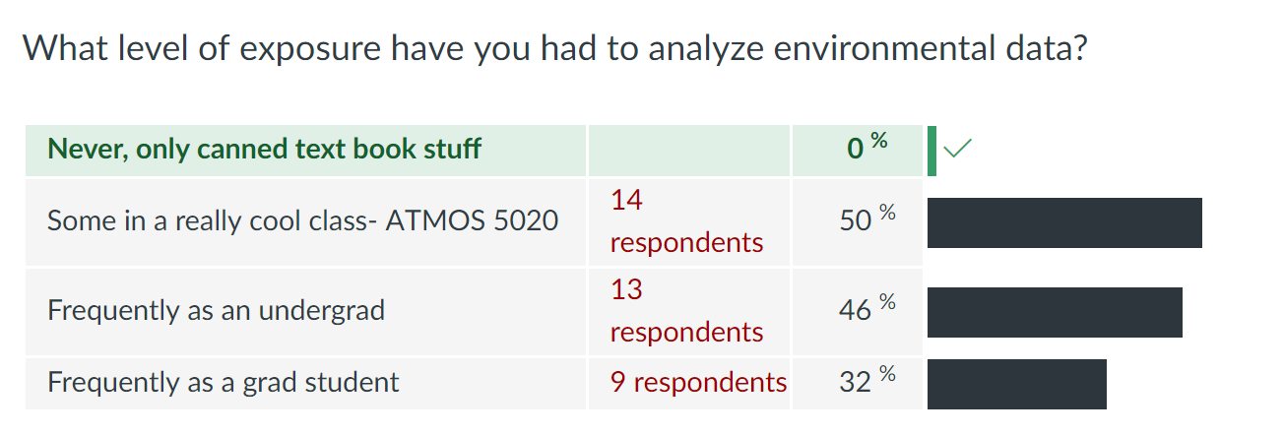

Slide 12
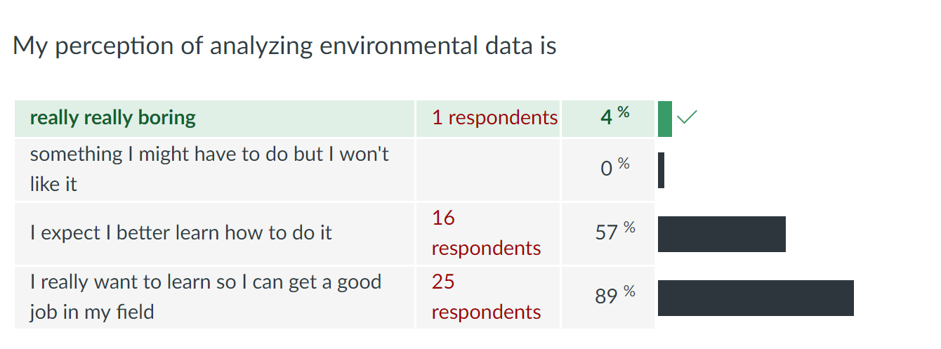

Slide 13
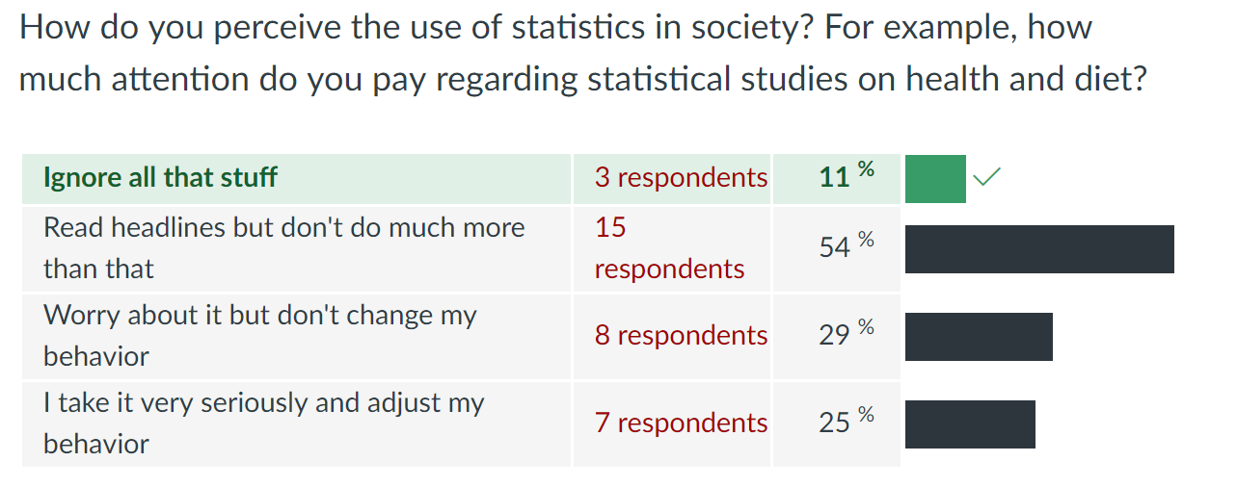

Slide 14
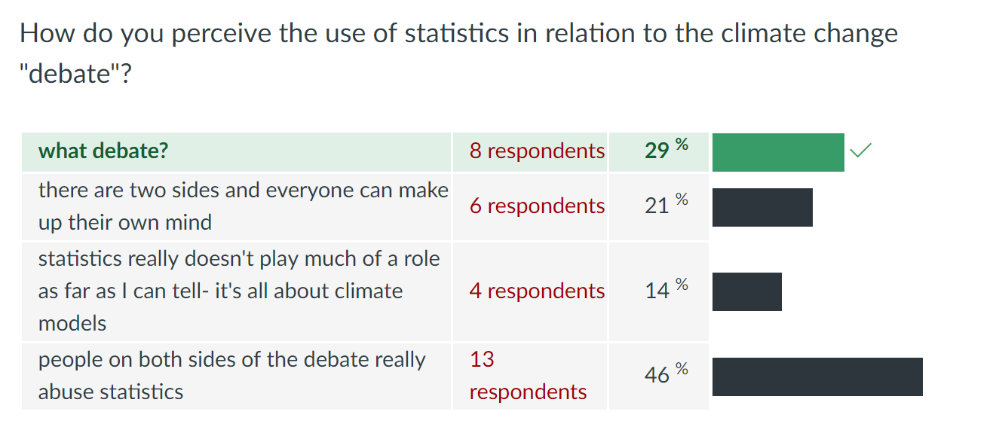

Slide 15
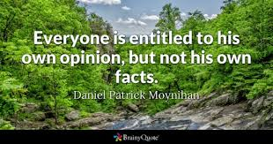

Slide 16
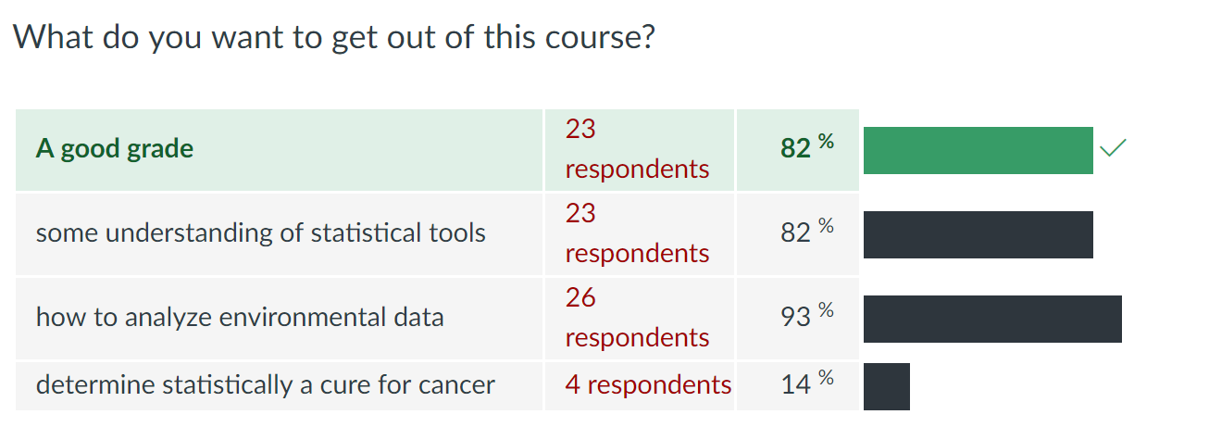

Slide 17
Common Goal is to Synthesize and Reduce Dimensionality
Statistical analysis of environmental data typically involves reducing the dimensionality of the data to a manageable size.
Which variable(s) do we need to consider?
Can we consider one variable (univariate analysis) or must we consider multiple variables (multivariate analysis)?
What time scales are we interested in? Hours, days, months, years? And, what region (local, regional, globally) or level in the vertical (surface, subsurface, upper air)?
Are the data available on a spatial grid or at specific points?

Slide 18
Large Dimensionality of Geophysical Data Sets
z
y
Space: x, y, z
x
t
t+1
Time: time (t) and forecast time (t_{f})
Parameter & Source (temperature, winds, different models, measuring systems, perturbations)
t
t+1

Slide 19
Climate
Statistics often misinterpreted as bookkeeping.
What is the warmest temperature on record at Salt Lake City?
What is the biggest snow storm at Alta?
weather and climate:
weather- state of the environment
climate- aggregate summary of the environment
Climate normal: arbitrarily defined reference state: 1981-2010

Slide 20
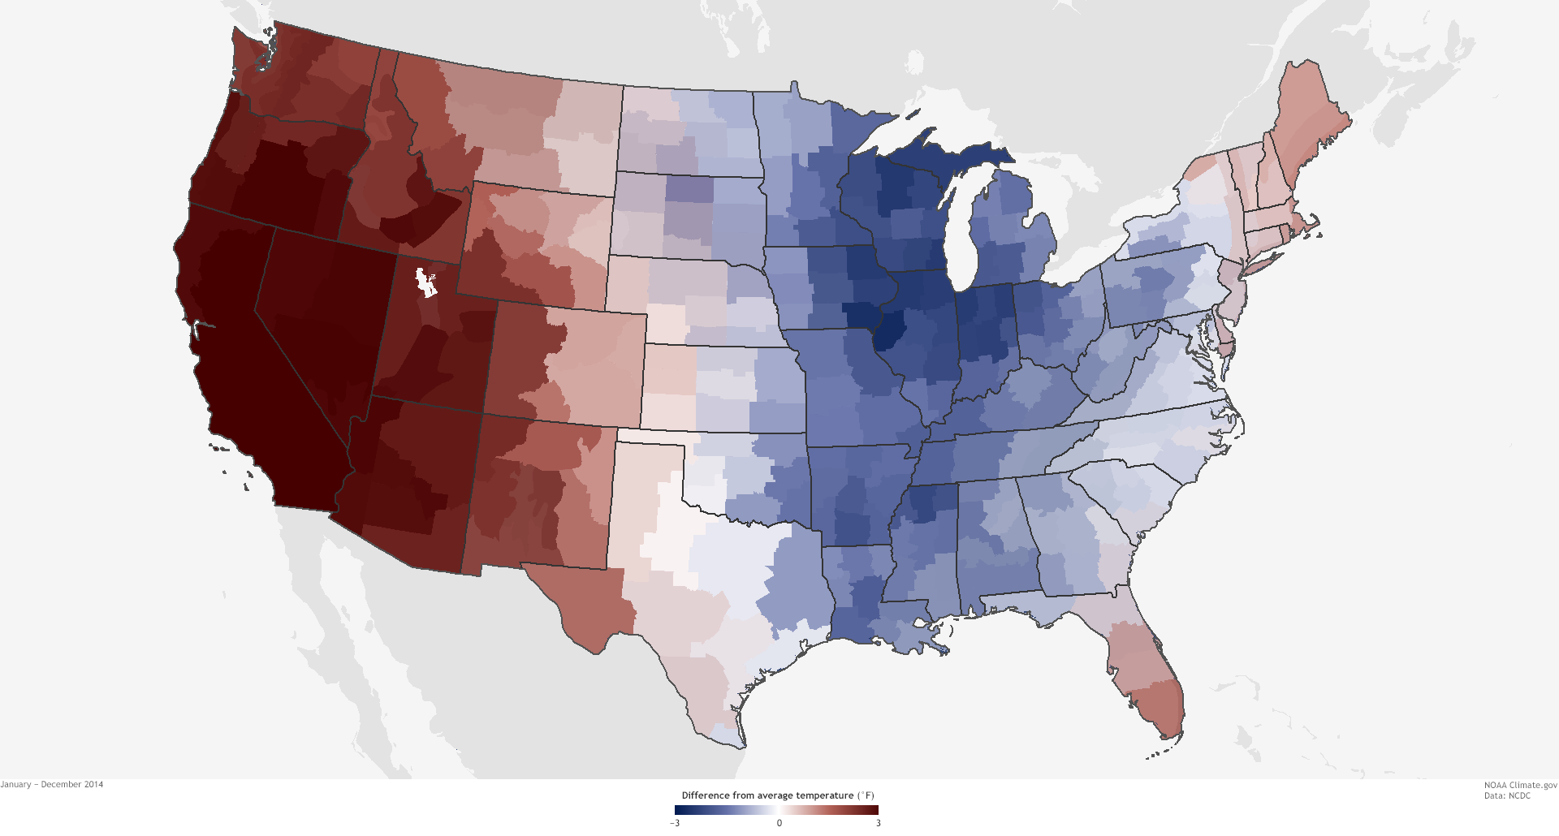
Climate.gov: 2014 temperature relative to climate normal

Slide 21
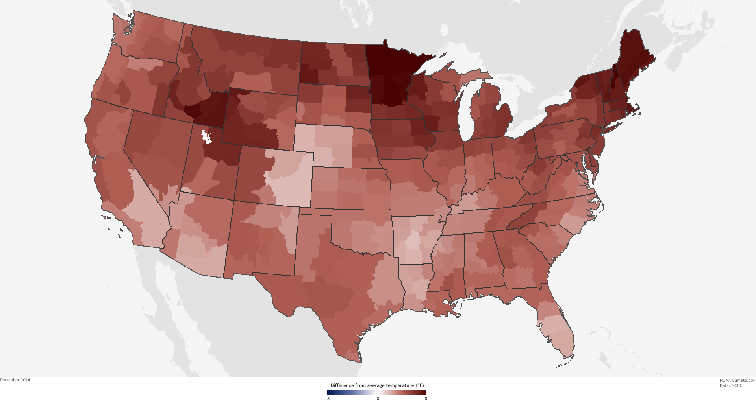
December 2014 temperature anomaly

Slide 22
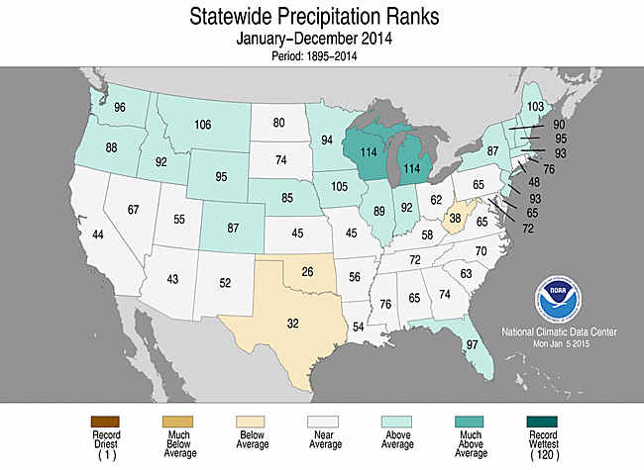
Comparing 2014 to 1895-2013

Slide 23
Why use statistics to describe the environment?
Environment controlled by innumerable factors, which we hope to segregate into a few critical factors from the rest that, for the most part, simply contribute to background noise
the characteristics of the system include linearly unstable processes such as baroclinic waves that cause growth of small features into larger ones
the characteristics of the system (dynamics, thermodynamics) are nonlinear and include discrete step functions (i.e., rain/no rain) that can lead to the amplification of small errors into large ones
the system is dissipative, which guarantees “stationarity”, i.e., the climate system will remain stable and not run away from the current state

Slide 24
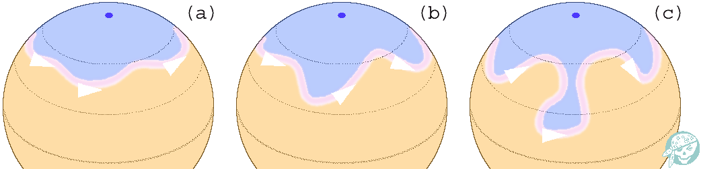
Baroclininc Wave Growth
Physical processes in atmosphere can be unstable at times but environmental system overall is “stationary”

Slide 25
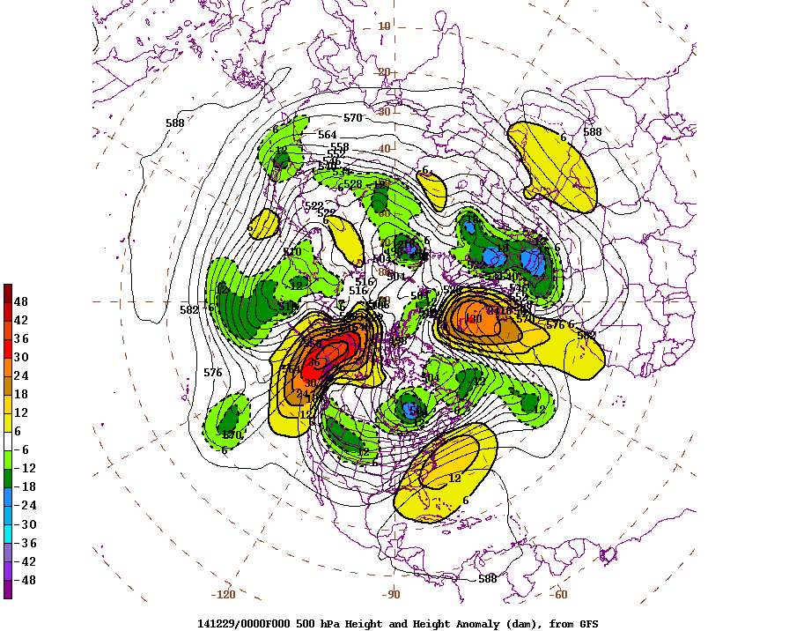

Slide 26
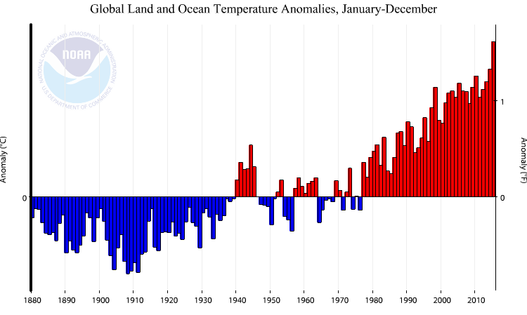
https://www.ncdc.noaa.gov/cag/time-series/global/globe/land_ocean/ytd/12/1880-2016

Slide 27
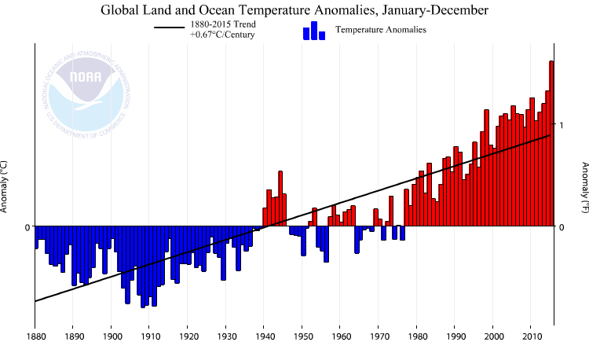

Slide 28
https://www.ncdc.noaa.gov/cag/time-series/global/globe/land_ocean/ytd/12/1880-2016

Slide 29
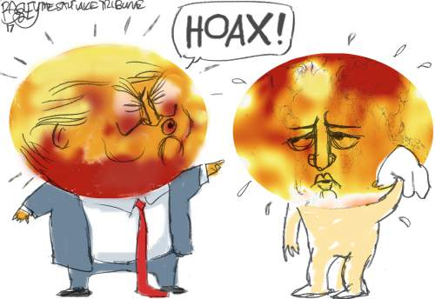

Slide 30
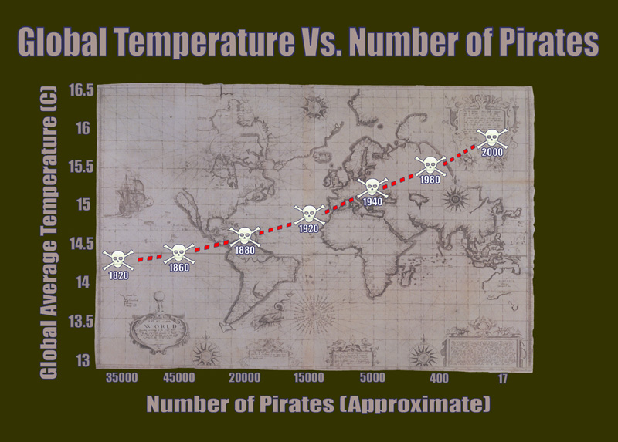
Causality vs. Simultaneity?
http://www.usnews.com/news/blogs/washington-whispers/2013/03/15/apollo-7-astronaut-uses-pastafarian-chart-on-pirates-and-global-temperatures-to-argue-climate-change-isnt-real

Slide 31
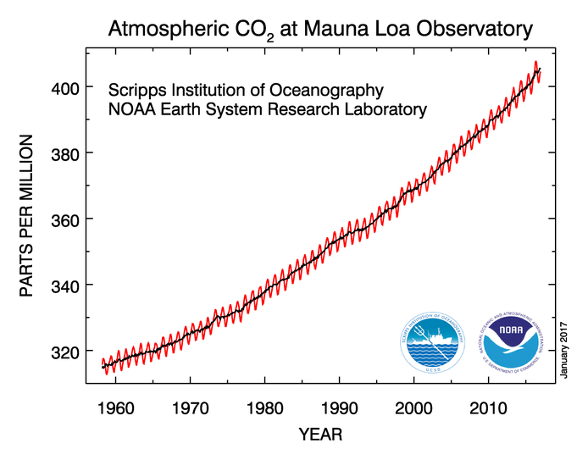
CO₂
https://www.esrl.noaa.gov/gmd/ccgg/trends/full.html

Slide 32
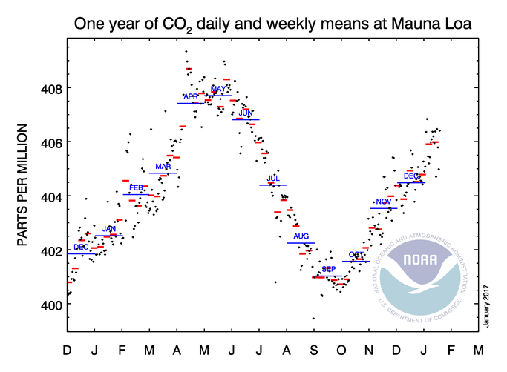

Slide 33
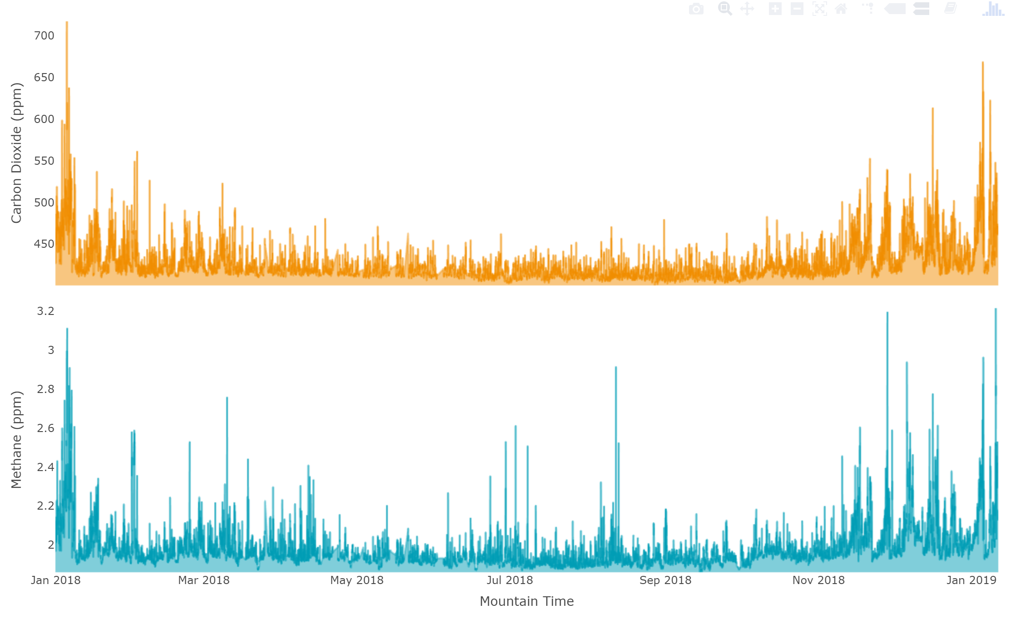
CO₂ on campus
http://co2.utah.edu/

Slide 34
Is consensus irrelevant?
[T]he work of science has nothing whatever to do with consensus. Consensus is the business of politics. Science, on the contrary, requires only one investigator who happens to be right, which means that he or she has results that are verifiable by reference to the real world. In science consensus is irrelevant. What is relevant is reproducible results.
—Michael Crichton, from “Aliens Cause Global Warming,” a lecture given at California Institute of Technology, Pasadena, California, January 17, 2003

Slide 35
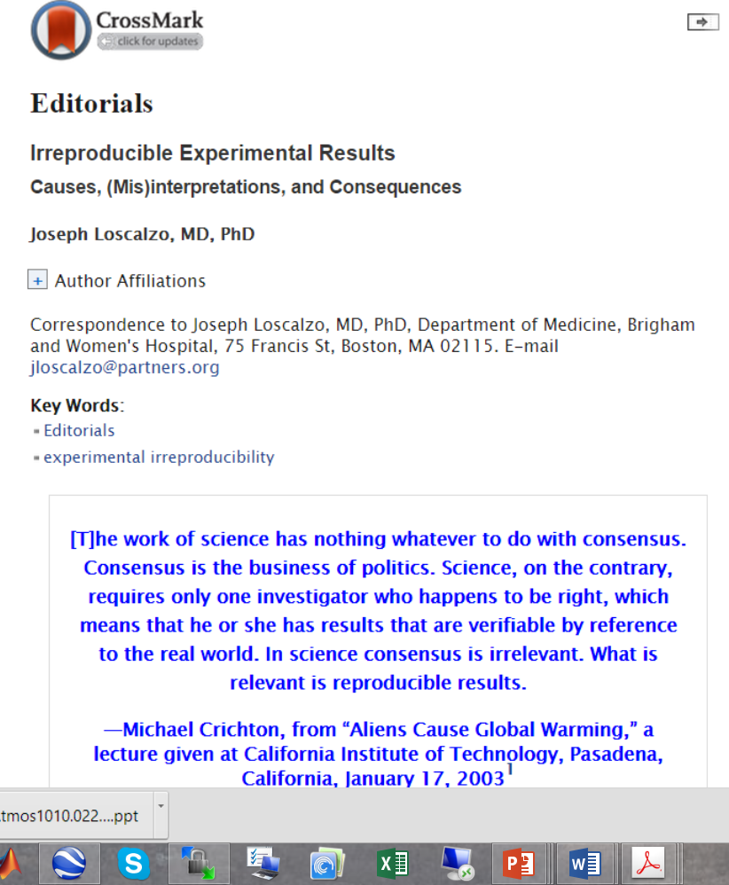
Reproducibility
The extent to which measurements or observations agree when performed by different individuals defines this important tenet of the scientific method.

Slide 36
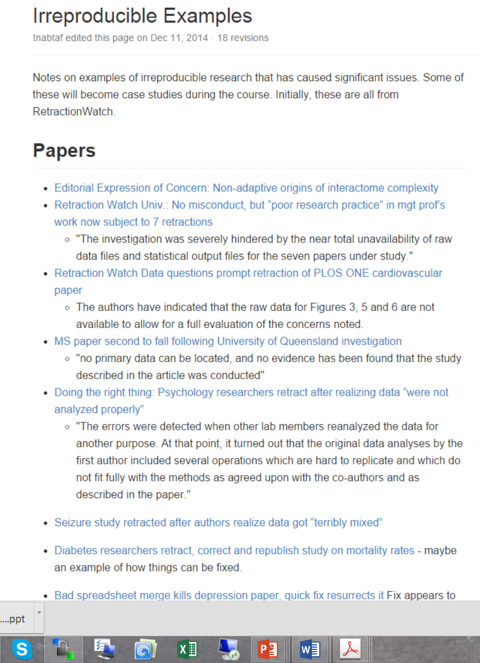
Reproducible-Science-Curriculum

Slide 37
Reproducibility vs. Replicability
Replicability is assessed by performing an experiment under exactly the same conditions at different times
reproducibility is assessed by performing similar, but not identical, experiments at different times, in different locations, and under somewhat different experimental conditions.
replicability reflects the technical stringency or precision of a specific experiment
reproducibility reflects the fundamental accuracy of an experimental observation
a precisely conducted experiment can be inaccurate, and an accurate experiment may be performed imprecisely—especially in biomedicine where many factors can account for irreproducible results

Slide 38
Statistics and Irreproducibility
errors in design, data analysis, and data interpretation.
Bias clearly plays an important role in promoting false-positive results.
Reasons for bias:
lack of experimental balance leading to an impassioned belief in one particular experimental outcome clouding objectivity;
perceived pressure to publish for academic advancement or to enhance the likelihood of competing successfully for grant funding⁷; and the lack of appeal of negative (or neutral) studies in most high-impact journals.
study illustrating the inverse relationship between the scientific hierarchy (physical sciences at the top, social sciences at the bottom, and biological sciences in between) and the publication frequency of “positive” results
Random and systematic errors contribute as well

Slide 39
Impact of Rarity on Irreproducibility
Black swan (Taleb)
outcome is theoretically reproducible, but so rare that a sufficient number of experiments needed to determine its frequency exceeds feasibility
Owing to its inherent rarity, it is effectively impossible to explain away an irreproducible result on the basis of a rare, singular event for which no supportive evidence can be marshaled
Examples of irreproducible events in environmental fields?

Slide 40
What a mess we’re in…
Over the past decade, the number of journal articles worldwide doubled from 1.1 to 1.9 million.
Of these, 0.5 million articles are published in the field of biomedicine, for an output of 1400 articles per day.
Given this volume alone, is it any wonder that an increasing number of articles are being published that contain irreproducible results?
Further-more, with the growth in search technologies, a greater number of articles is being retracted over time: ~40/year in the late 1990s, ~300 in 2010, and ~400 in 2011.
The reasons for these retractions include plagiarism, data manipulation (especially in figures), and proven data falsification;
however, irreproducibility resulting from innocent causes may also be included in this pool of retracted publications without being recognized as such.
With as many as 50% of all articles listed in PubMed never cited at all, one can conclude either that the work is of minimal significance and not worthy of further pursuit or that it has been pursued and could not be reproduced.
The extent to which these two explanations account for this statistic has not been (nor cannot easily be) determined.

Slide 41
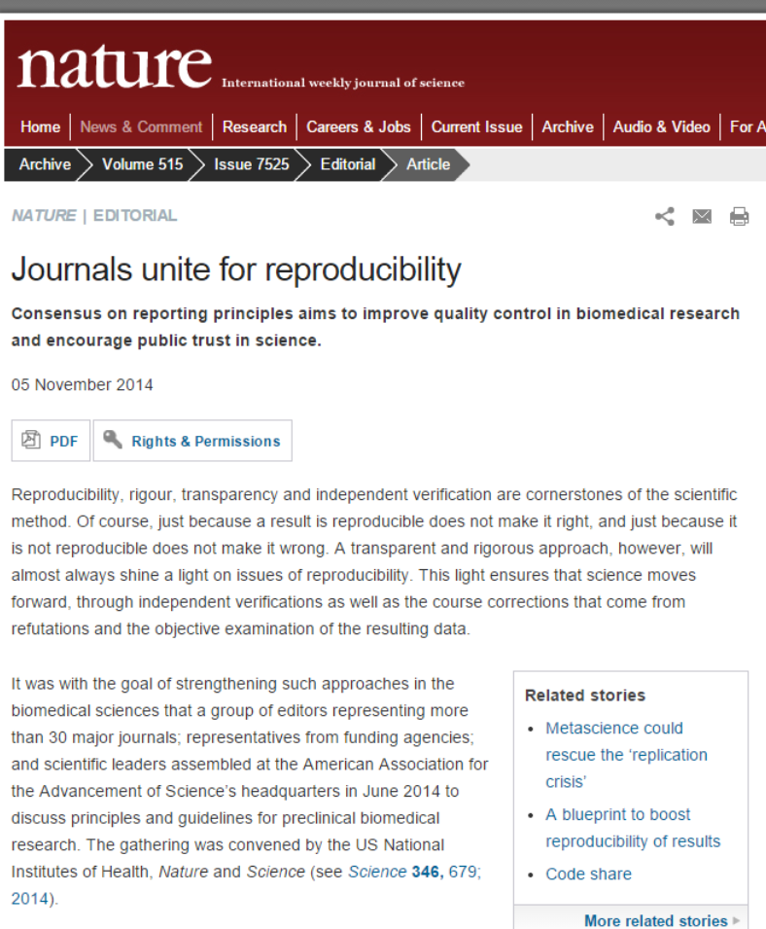
Taking Steps
Nature
Reproducibility, rigour, transparency and independent verification are cornerstones of the scientific method. Of course, just because a result is reproducible does not make it right, and just because it is not reproducible does not make it wrong.
The guidelines recommend that journals include in their information for authors their policies for statistical analysis and how they review the statistical accuracy of work under consideration.

Slide 42
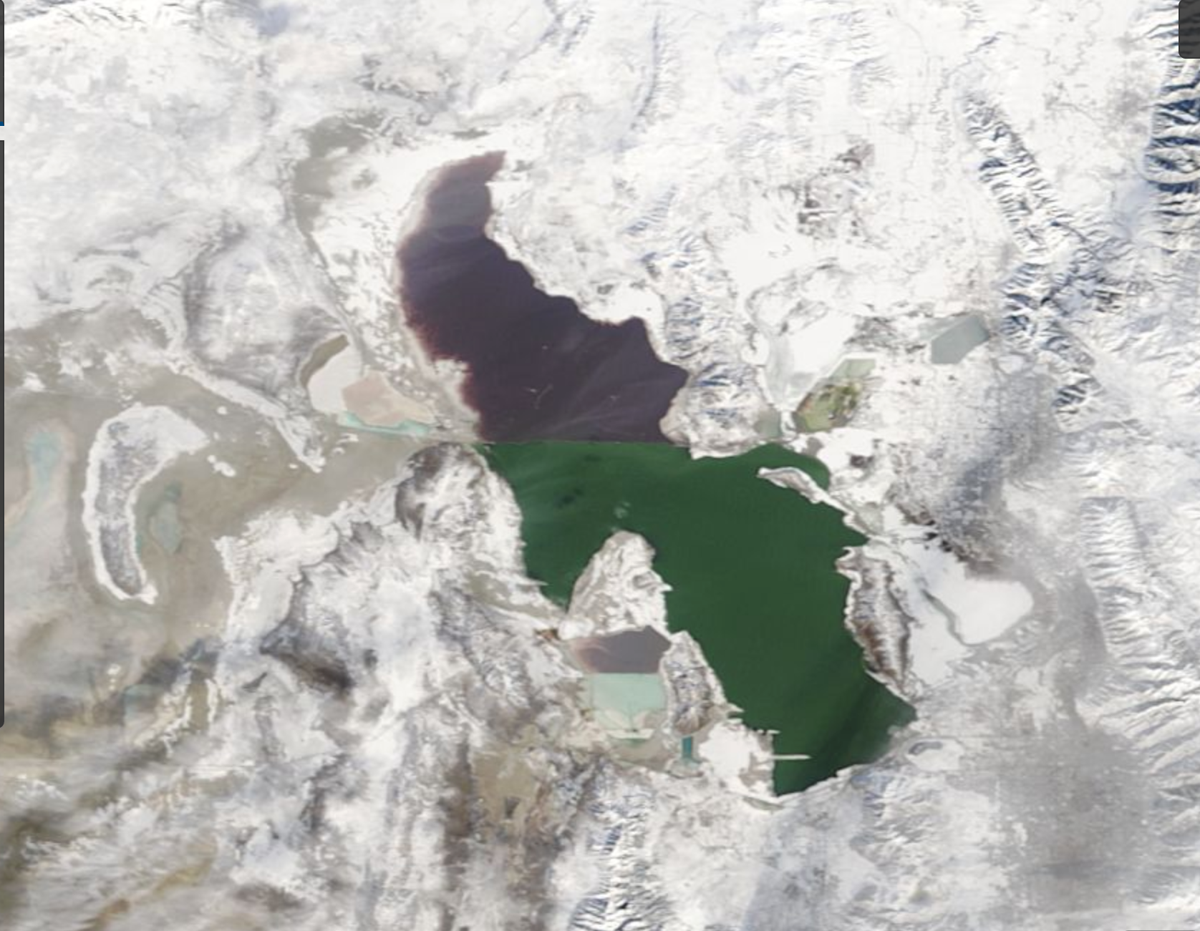
Great Salt Lake January 9, 2019

Slide 43
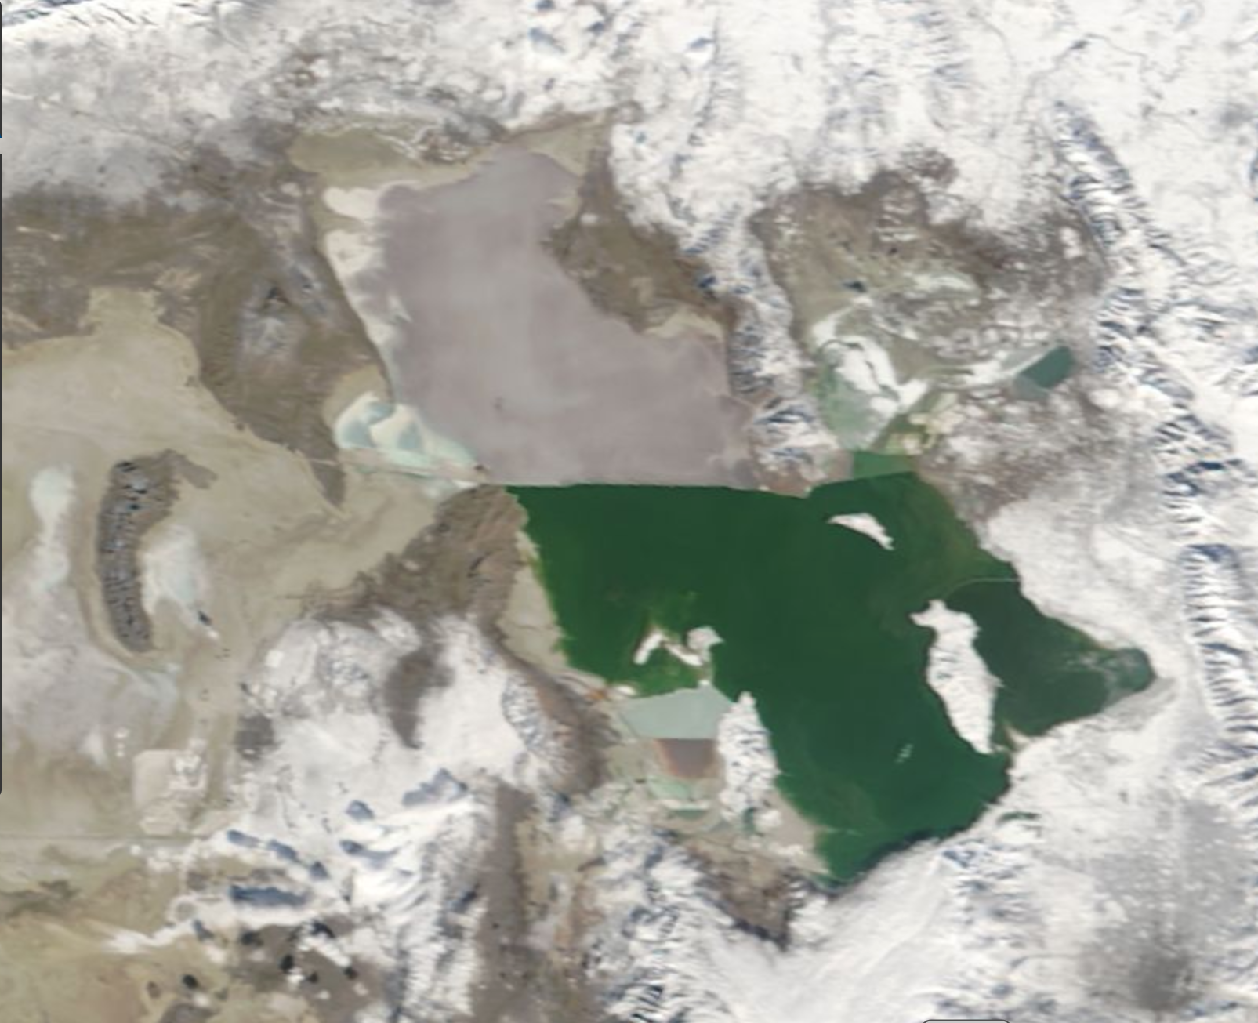
Great Salt Lake December 25, 2000

Slide 44
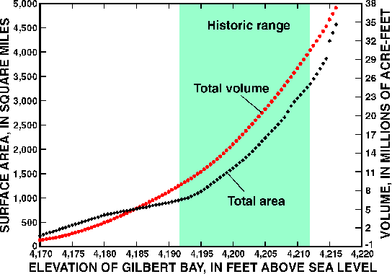
Great Salt Lake
http://ut.water.usgs.gov/greatsaltlake/elevations/

Slide 45
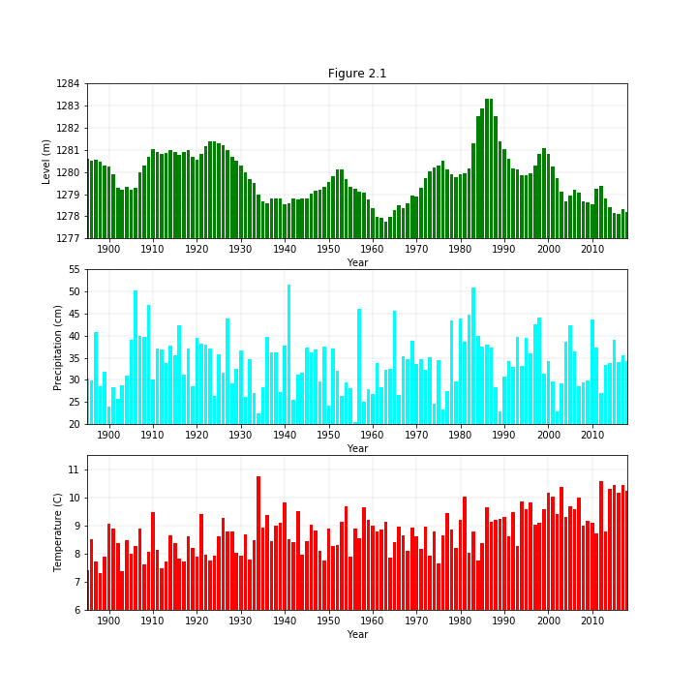
Great Salt Lake level
Utah precipitation
Utah temperature

Slide 47
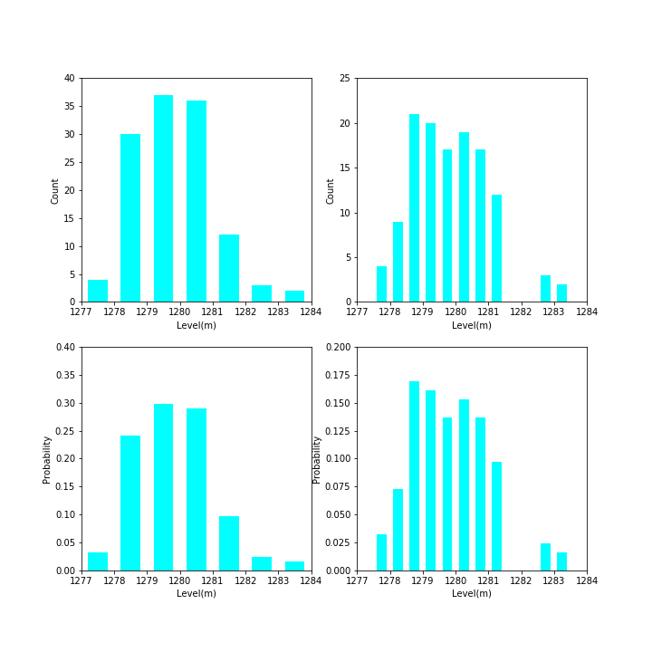
Figure 2.2. Histogram of lake level using 1m (upper left) and .5 m (upper right) intervals. Empirical probabilities that lake level falls within 1 m intervals (lower left) and within 0.5 m interval (lower right).

Slide 48
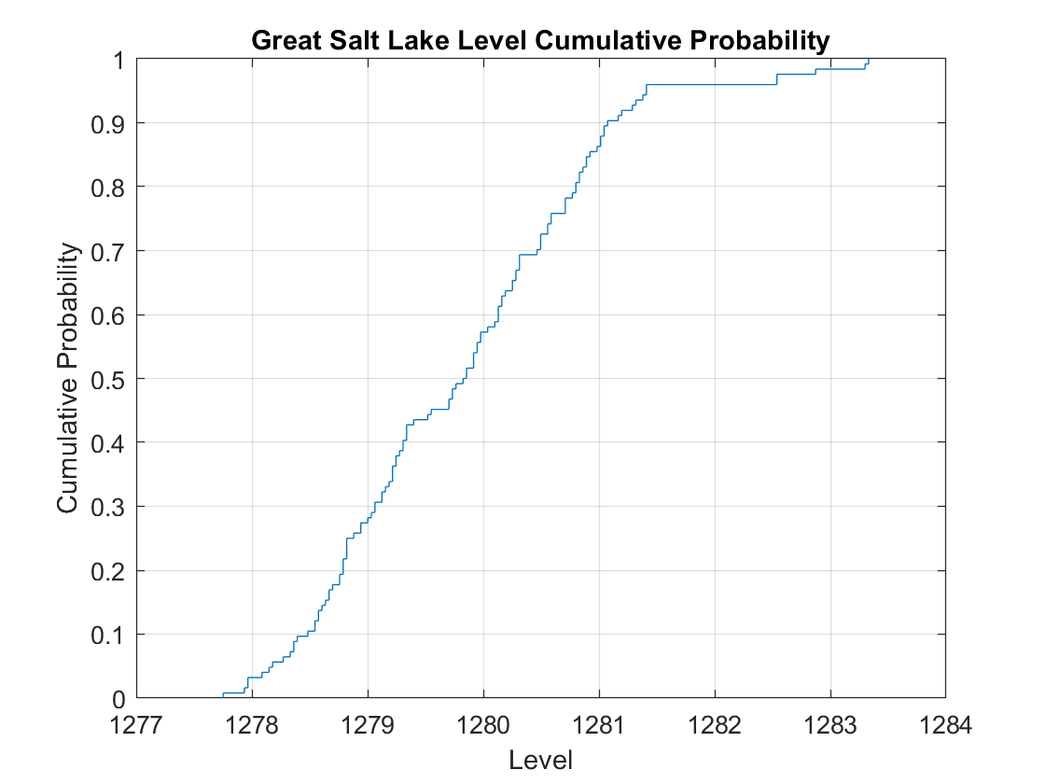
Figure 2.3. Cumulative frequency distribution of lake level.

Slide 49
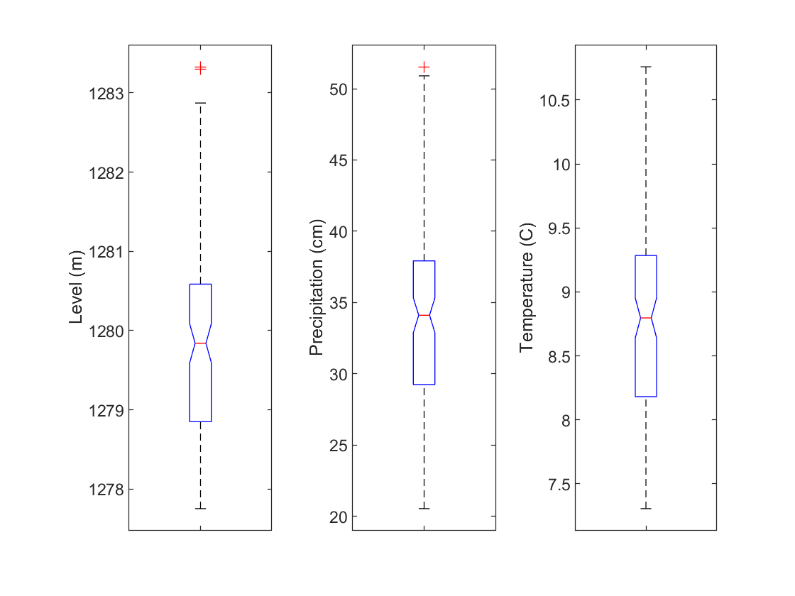
Figure 2.4. Boxplots of lake level (left), Utah precipitation (center), and Utah temperature (right).

Slide 50
What you will be doing
Class Wed and next Wed in MLIB 1110 (no class Monday)
Read chapter 2 in text
Read chapter 2 Notes
In class Assignment 3 on Wednesday
Complete Assignment 4 as really basic introduction to Matlab
Due 22nd

